Slide 1
Build the Maze

Slide 2
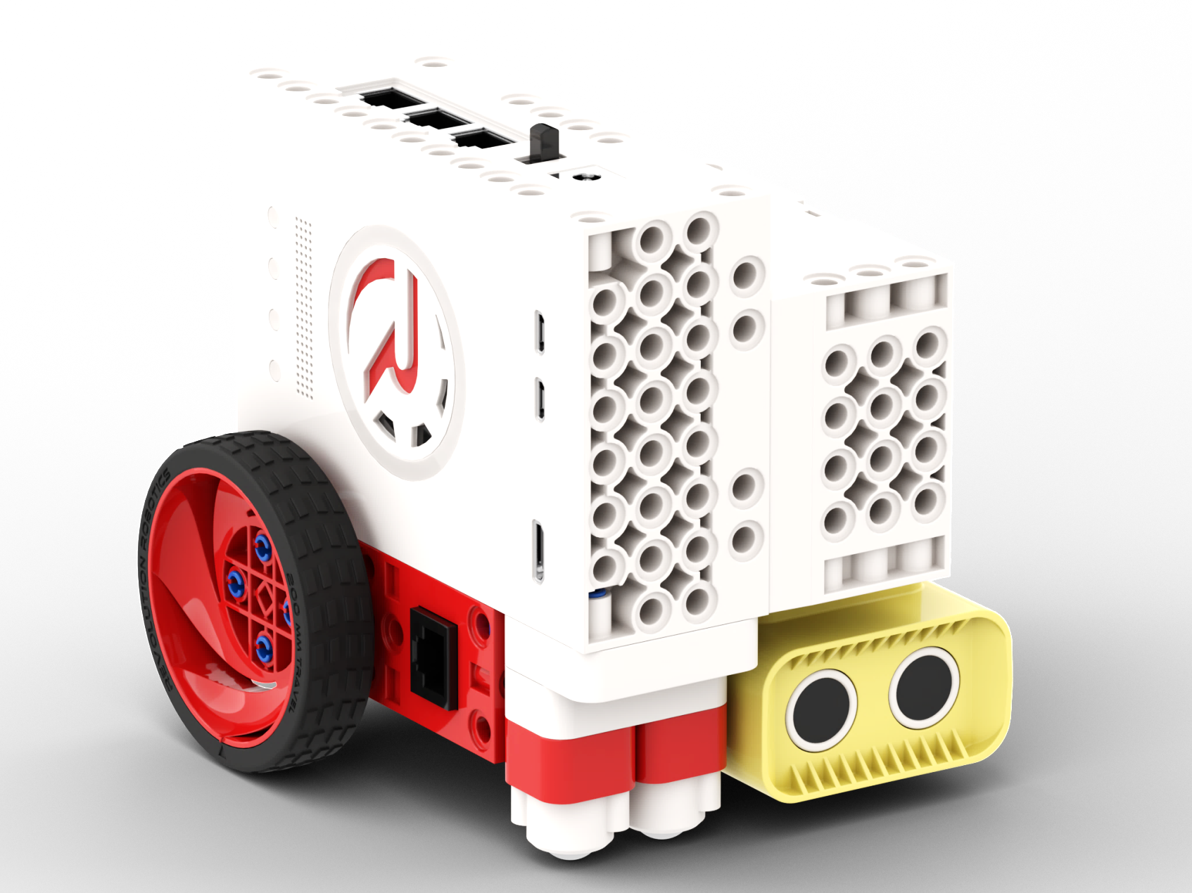
Build the Robot

Slide 3
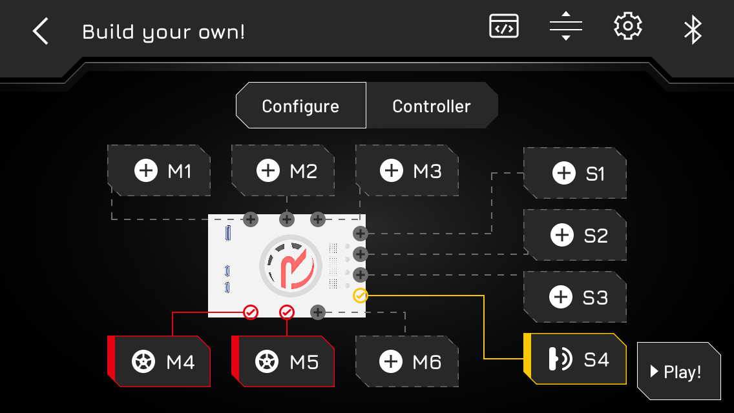
Configure the Robot
M4 drive RIGHT
M5 drive LEFT
S4 DISTANCE SENSOR

Slide 4
Speed Challenge
Drive the Robot through the maze.
Start from the yellow rectangle.
Minus 5 seconds for touching a wall.
Good Luck!
START

Slide 5
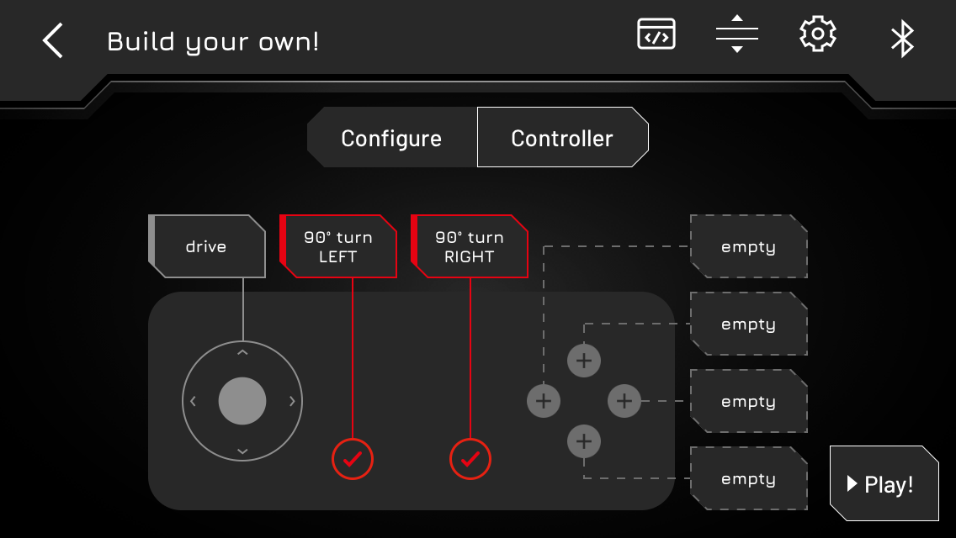
Program Controller
Program 90° turns
90° LEFT 90° RIGHT
Drive through the Maze
using the buttons

Slide 6
Autonomous driving
Program the Robot to
navigate The Maze
on it’s own

